Slide 1
Typecasting and equality operator in JavaScript -by Nitesh

Slide 2
Implicit Type Conversion
JavaScript performs implicit type conversion automatically in certain situations.
Examples:-
1. Let a=10+”1”;
Console.log(a);
2. console.log(10+”1”-1);
3. console.log(10+’A’);
4. console.log(10+’A’-1);
5. console.log(“ABC”-1);

Slide 3
Explicit Type Conversion
Converting data types manually using built-in functions.
parseInt(), parseFloat(), String(), Number(), Boolean()
Examples:
Console.log(10++’6’);
Console.log(10-+’6’);
Console.log(+[]);
Console.log(+[[[[[]]]]]);
Console.log(+[[],[]]);

Slide 4
Equality Operator
Loose Equality(==): does not compare data types, only compare values
console.log(1==1);
console.log(1==‘1’);
console.log(1==1.0);
Strict Equality(===) : It also compare the data type.
1. console.log(1===‘1’);

Slide 5
Equality with type conversion
Console.log(“” ==0);
Console.log(0==[]);
Console.log(“” ==[]);
Console.log(“ “==0);
Console.log(“ “==[]);
Console.log(“ ”==0);
Console.log(“”==“ ”);
Console.log(“ “==“”);

Slide 6
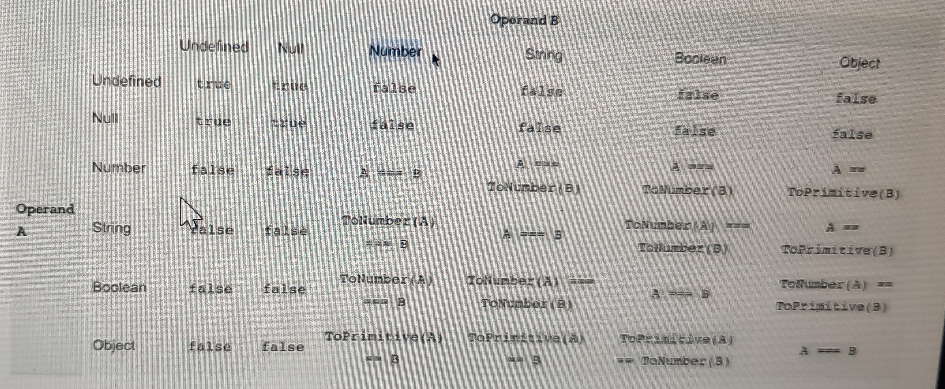
Equality operator table

Slide 7
Pass By Value and Pass By Reference
Let a=[1,2,3];
Console.log(a==[1,2,3]);
Shallow copy: A shallow copy of an object or array in JavaScript creates a new object or array, but the nested elements within the copied object still reference the same objects as the original.
Methods:
Spread operator
Object.assign()

Slide 8
Deep Copy: Deep copy makes a copy of all the members of the old object, allocates a separate memory location for the new object, and then assigns the copied members to the new object.
1.JSON.parse(JSON.stringify());

